Slide 1
Other Transaction Authority Information Session
August 13th, 2019
Mark A. Muñiz and
David Hector
Army Contracting Command - Orlando
Agreements Officer(s)

Slide 2
Why are we here?
Other Transaction Authority (OTA) Refresher
ACC – Orlando Command Philosophy
Competition Process
Trends and Lessons Learned
Q&A Period

Slide 3
What is an Other Transaction?
Legally binding agreement not required to comply with the FAR
R&D/Prototype projects that enhance mission effectiveness of military personnel and the supporting platforms, systems, components, or materials
Within ACC-Orlando, we live in the 10 USC 2371b world – prototype projects (vice research projects)
Training and Readiness Accelerator (TReX) is command vehicle
Spur innovative development, demonstration, and expedited delivery of prototypes to increase Warfighter readiness
DAU Other Transactions ***GUIDE***
Provides ability to streamline acquisition and maximize flexibility
Notes:
Flexibility is the number one advantage of the tool, contrary to the belief that speed is the number one advantage. Speed is a result of the streamlined flexibility, when appropriate.

Slide 4
What is an Other Transaction?
What is considered a “prototype”?
The definition of a “prototype project” in the context of an OT is as follows: a prototype project addresses a proof of concept, model, reverse engineering to address obsolescence, pilot, novel approach of commercial technologies, for defense purposes, agile development activity, creation, design, development, demonstration, of technical or operational utility, or combinations of the foregoing.
A process, including a business process, may be the subject of a prototype
May be physical, virtual, or conceptual in nature
Ancillary work efforts necessary for the completion of the project may be included (e.g. test site training, limited logistics support, NET, initial spares)
4

Slide 5
What is an Other Transaction?
Must meet one of following conditions:
At least one nontraditional defense contractor participating to a significant extent
All significant participants in the transaction are SB or nontraditional
1/3 of total cost of project to be paid by non-Government entity
Can be reasonable value of equipment, materials or property used
Competitive procedures shall be used to maximum extent practicable
Commercial accounting standards
Negotiable payment milestones
Negotiable terms and conditions
Negotiable IP and data rights
A follow-on production effort may be awarded without competition
An OT does NOT replace any other contracting method, it is simply an additional tool
5
Notes:
- Non-traditional defense contractor: an entity that is not currently performing and has not performed, for at least the one-year period preceding the solicitation of sources by the DoD for the procurement or transaction, any contract or subcontract for the DoD that is subject to full coverage under the CAS.
- “Significant” is not defined in the statute. “AOs should not establish blanket rules or thresholds for determination of significance, and agencies must not establish local policies which infringe on the AO’s judgment in making such determinations. Blanket policies which provide that expected NDC/nonprofit research institution participation must represent a predetermined percentage of total project value, or total labor dollars, etc., to be considered “significant,” are arbitrary and infringe upon the Agreement Officers responsibility to make a reasoned, prudent and independent determination for each individual prototype project.”
- Commercial Accounting Standards: Accounting principle that is based on profit and loss, also called profit accounting.
- Follow-On w/o competition: assumes initial competition was held and successful completion; not necessarily the end of the project – but when you define it.

Slide 6
What is an Other Transaction?
What it is NOT:
A procurement contract, a grant, a co-op agreement
Grant/co-op clauses do not apply
Immune from laws and regulations related to funding or program requirements (i.e. fiscal and property laws)
MDAP requirements of DoD 5000.02 still apply
Limited by funding color – nature of work determines
Still dominated by RDTE
Protestable at GAO outside of use of statute – CICA does not apply
COFC still applies for laws and regulations
6

Slide 7
OTA Command Philosophy
Delivery
Flexibility
Transparency
Simplicity
Efficiency
7
Notes:
Flexibility: There’s no one-size fits all model to finding unique solutions. And not everything needs to be evaluated in a paper drill.
For example, we provide our government customers with a 1-page workflow on competitive process options to help them open their minds to new ways to attack their problems.
Transparency: We are not hiding behind a pay wall. Every opportunity we post is open for the world to see – and we double tap with posting new opportunities, and awards, in multiple locations. And when we make decisions, we don’t sit on them 6 months. When we know, you’ll know. (timely feedback)
Simplicity: Every step of our process is questioned for value-capture – if not value added and not a requirement, we strive to eliminate it.
Efficiency: Our team has an almost insatiable desire to tinker with our processes with the pure goal of simply doing things, better. With greater efficiency, comes greater speed… which leads to the final bridging block, delivery
Delivery: Our bread and butter. We knew from day one that we wanted TReX to be about putting capability into the hands of our Warfighters and bridging the dreaded valley of death. This is why we are here. This is why it matters so much that we don’t conduct business as usual. When we follow the vision, the command philosophy, we deliver capability that makes our Warfighters and all that support that Warfighter better prepared than our enemies.

Slide 8
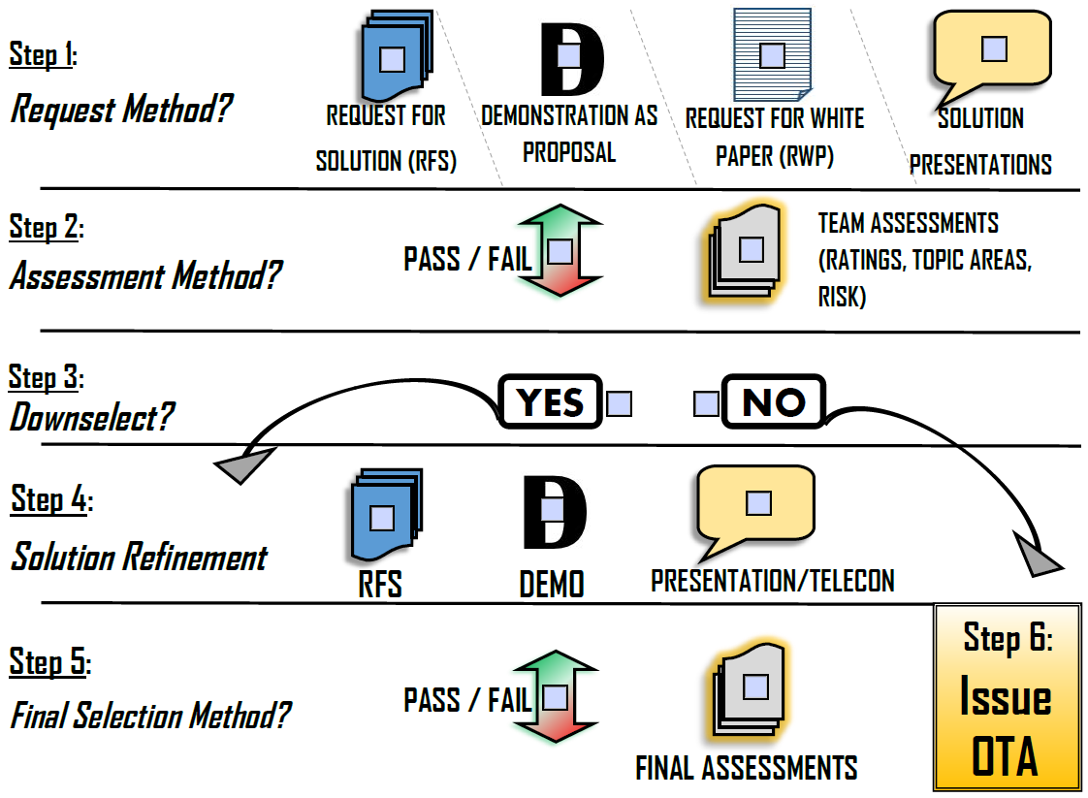
Competition Process Options
8

Slide 9
ACC-O Typical Competitive Flow Chart
Develop RFS:
Includes SoN & Annexes
DD-254
FOCI Info
EULA Info
Etc, as applicable
Develop PAA
- Signed by AO and PM
Requirement Arises
Release RFS
Develop SoN
Receive Submissions
Conduct Phase 1 Evaluations
Award Recommendation Briefing and Decision
Solution Presentations / Demos
Timely Feedback Sent to Successful and Unsuccessful Vendor(s)
Conduct Phase 2 Evaluations
Down-Select Briefing and Decision
Notification Sent to Selected and Non Selected Vendor(s)
SOW Collaboration Phase w/ Selected Vendor(s)
OTA Approval D&F Signed by SCO/HCA/SPE/ATL
Agreement and Attachments Finalized
Agreement Executed (W/ NSTXL for projects under TReX)
Legend:
PAA – Prototype Acquisition Approach (~Acq Plan)
SoN – Statement of Need (~SOO/SOW/PWS)
RFS – Request for Solutions (~RFP)
Submissions = Proposals / White Papers / Bids / Quotes / etc
Solution Presentations / Demos ~ Discussions
= Decision Point = Legal Touchpoint
Performer Agreement Executed between NSTXL and Vendor (for projects under TReX)
9
Notes:
All evaluations are conducted solely by Government personnel. Any contractor support utilized as SMEs is announced through the RFS process and SMEs are limited to an advisory role.
Although this is the ACC-O typical flow chart, it is not mandatory nor appropriate in all situations. We will remain flexible based on the requirement at hand.

Slide 10
Trends and Lessons Learned
Clearly lay out your assumptions
Bid creatively, but be crystal clear on what your proposing
Great ideas do not mean you don’t have to follow RFS instructions
When we ask for your questions/comments, send them in
Technical questions AND evaluation process
Understanding of FOCI limitations (DSP-5 and TAA)
10

Slide 11
Workload
Actively managing 23 awarded prototype projects
TReX (15 projects, 17 vendors)
SCETI, JMAS, ADA LTE, LV-Ratio, PCTE CIC-2, UAS Instrumentation, ATHENA, WITS, NOBLE (IDE (2 vendors), NOSS, NAMS/NOME), MITS, PCTE CIC-3 (3 vendors), CRW-Mobile Power, AVDT Drivetrain
STE (5 projects, 8 vendors)
Common Synthetic Environment, One World Terrain, Reconfigurable Virtual Collective Trainer, S/SVT Weapons Optimization (2 vendors), Exercise Planning and Assessment Capability (3 vendors)
Stand-Alone OTAs (3 projects, 5 vendors)
Quantum Technologies for Threat, PCTE CIC-1 Follow-On (3 vendors), AVDT Chassis
11

Slide 12
Resources
10 USC 2371b: https://www.law.cornell.edu/uscode/text/10/2371b
DAU OT Guide: https://aaf.dau.edu/ot-guide/
Strategic Institute for Innovation in Government Contracting: http://www.strategicinstitute.org/resources/
LinkedIn OTA Community of Practice: https://www.linkedin.com/groups/12090427
12

Slide 13
Questions?

