Slide 1
NSTXL
Marketplace
Project Overview

Slide 2
Goal 1:
To lay the Marketplace Foundation
Goal 2:
To support and bring value to membership on cybersecurity compliance journey

Slide 3
Marketplace
3 Pathways to Compliance
1. Teaming & Premier Partners
2. Compliance Providers
3. Virtual Desktop Infrastructure

Slide 4
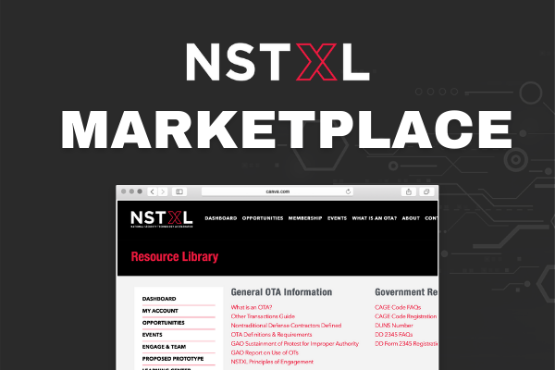
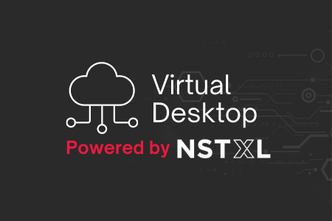

Slide 5
Pathway 1:
Teaming Partners &
Membership CMMC Compliance
Notes:
What is premier partners?

Slide 6
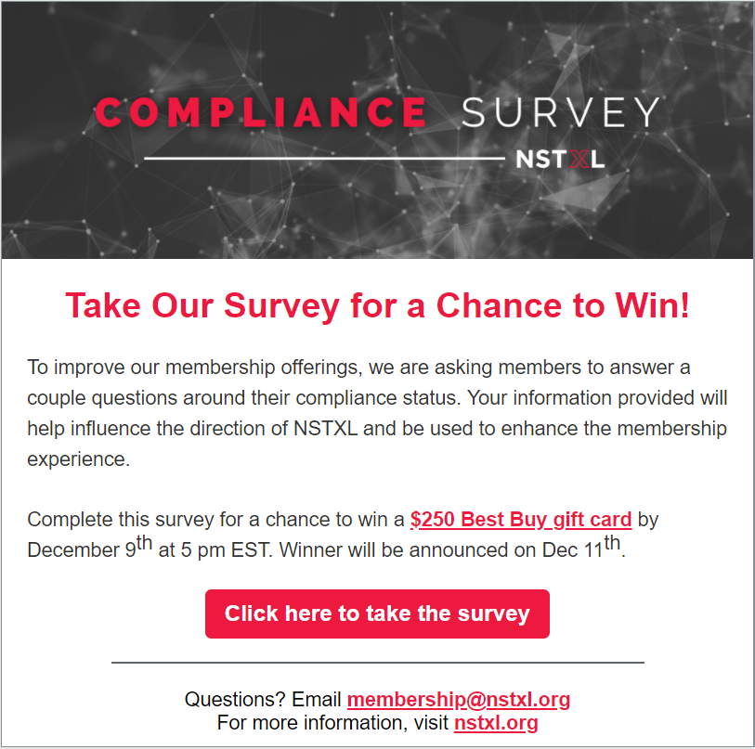
Subject Line: Do you have 5 minutes?
Pre-header: Chance to win a $250 Gift Card
Survey Emails:
November 19th
Open Rate: 21%
Click-Through: 14%
November 24th
Most Survey Responses
Open Rate: 18%
Click-Through: 17%
December 2nd
Open Rate: 18%
Click-Through: 10%
December 7th
Open Rate: 17%
Click-Through: 8%

Slide 7
21 Unique Companies
40 Unique Companies

Slide 10
Outreach
Team Actions:
1. Calle & Hannah build pipeline of PPN leads
Quick Stats:
2. Qualification pre-screening based on self-reported compliance status
59
Unique Members Contacted
6
Member Commitments
4
Approved Submissions
3. Hannah & Jeff conduct 1:1 outreach
86
Survey Responses
78
Unique Organizations
47
Attesting CMMC 3+/NIST 800-171
Notable Takeaways:
1. Guinea Pig Apprehension
2. Lack of clear CMMC guidelines continues to produce miscommunication
3. Forward-looking prospects for expansion are strong after soft launch and as CMMC details materialize
Notes:
Jeff speak to the main goal in working with Hannha and Calle to identify clear targets for CMMC compliance.
Hannah speak to how she developed this list. 1. people we knew 2. List 3. vIITSEC

Slide 11
Member Submits Formal Application
POC Info
Information Collected in Membership Inbox and Sent to Larry
Larry, per his request, vets and approves or denies application
Membership Team Notifies Applicant
Company Bio
Compliance Status & Documentation
Website
Logo
Form and documentation will live in HubSpot (future state)
Partner is Featured on Resource Page
Approved applicants celebrate
Denied applicants compile acceptable documentation and re-apply
Premier Partner Process
Annual Check-ins to Ensure Compliance

Slide 12
Pathway 2:
Compliance Providers

Slide 13
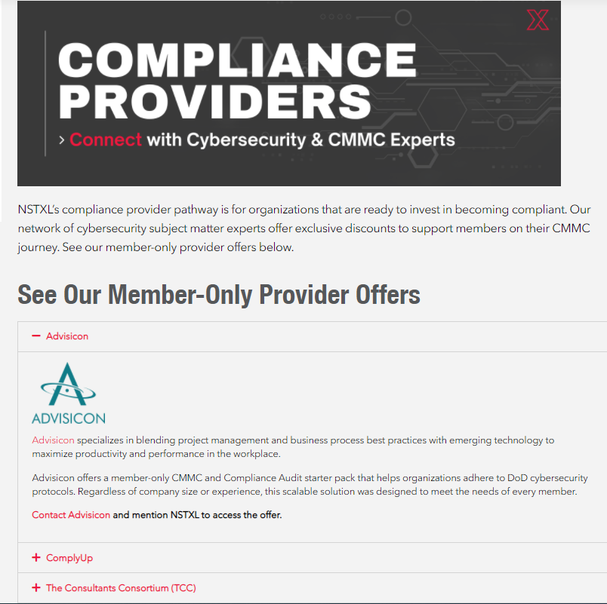

Slide 14
LIVE DEMO

Slide 15
Pathway 3:
Virtual Desktop Compliance
What is NSTXL’s VDI
Features & Benefits
Quick walkthrough

Slide 16
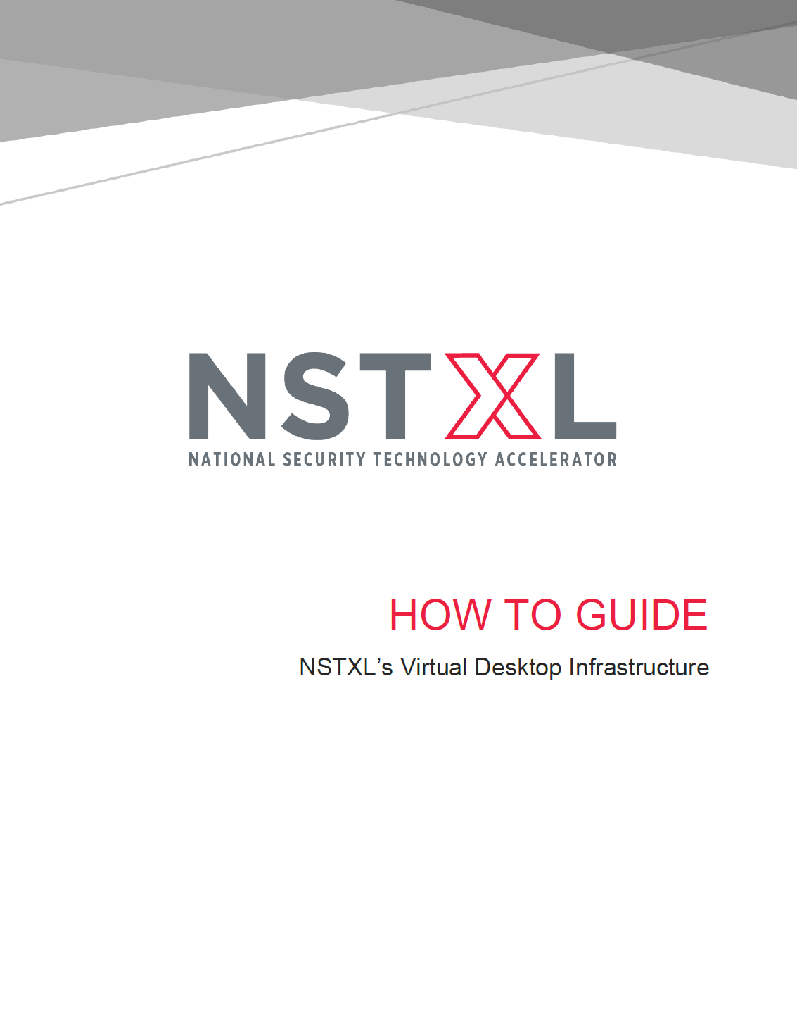
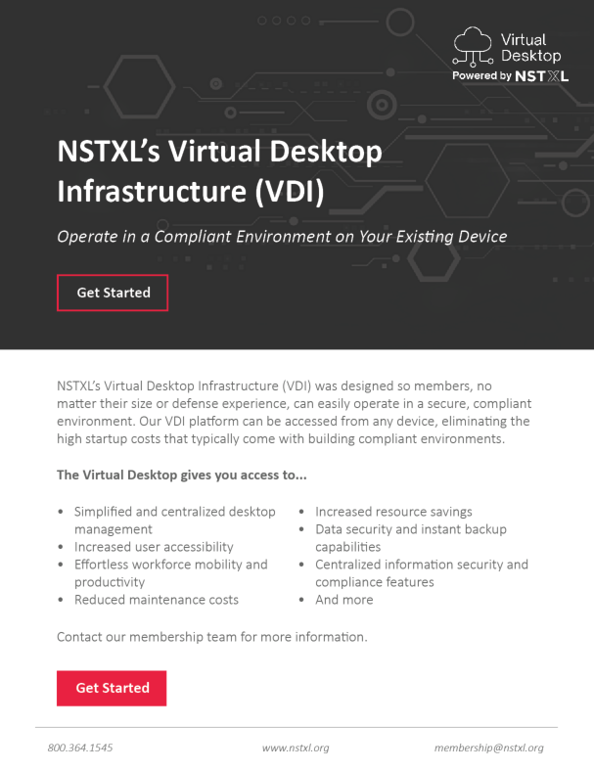
What is NSTXL’s VDI?
Providing small to medium sized companies a means to gain compliance.
Allows the user to work securely with the full office suite and more
Features and Benefits
Flexible, tailorable and scalable
You can BYOD
Reduces startup and maintenance costs
Data security
Instant backup capabilities
Simplified and centralized desktop management
Deploys and scales quickly
Unlimited users can be added

Slide 17
Walkthrough

Slide 18
VDI Marketing Process
Website Form
Partnership Team to call
If interested, forward to Operations
Product Link Sent

Slide 19
Final Thoughts
This was a great first start at collecting members compliance levels.
Future State
We need to make compliance status a requirement
Reverification process. How much do we want to own? How much can we automate?
Survey / Monitor / Evaluate VDI – Return worth effort? Is this bringing value to members?
Market Research / Analysis
Identify need and offering gaps
Use findings to define future state of marketplace and offering categories
Provider Approval Committee & Process
Marketplace application needs – What does the future UX look like?

