Slide 1


nstxl.org

Slide 2


Cyber Security & Compliance
Notes:
Steve Palamara – Director of Business Development
Intended Audience – DoD Supply Chain

Slide 3


AGENDA
Cyber Security Landscape – Steve Palamara – Director of Business Development
DFARS & CMMC Certification – Tim Luzadder – Director of Security Services
NIST 800-171 Compliance – Chad Hughes – Cybersecurity Architect
Questions & Answers

Slide 4
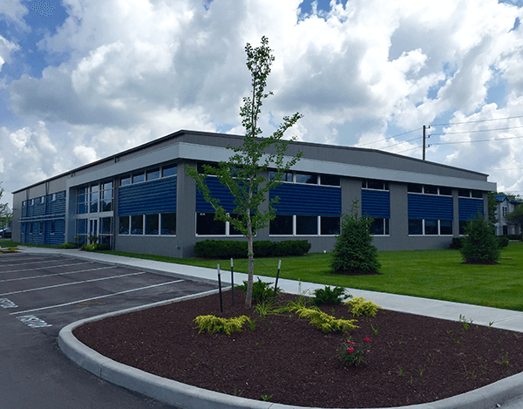

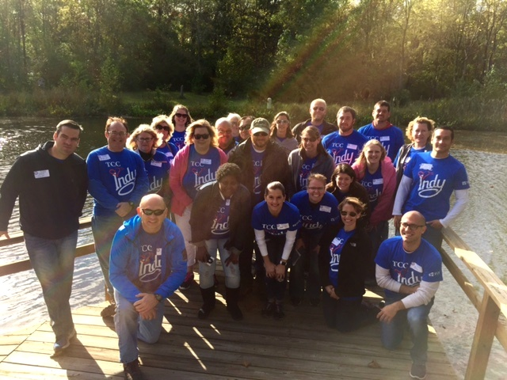

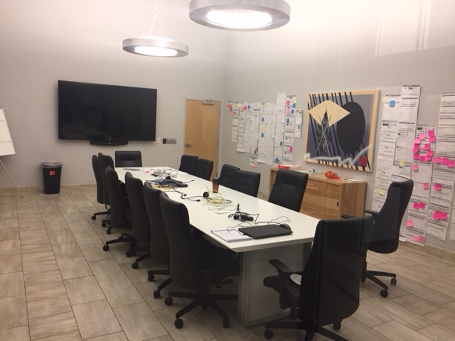
COMPANY OVERVIEW
WHO WE ARE
Notes:
Company Overview
Indianapolis based IT Consulting company Founded in 1996. We have a division in Urbana Illinois – 250 IT Professionals - Clients in over 20 States.

Slide 5




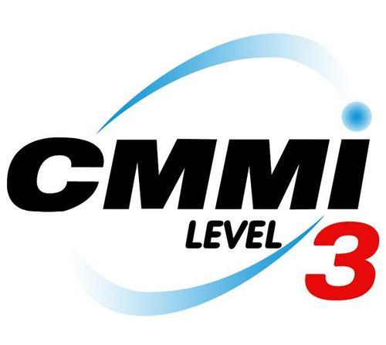
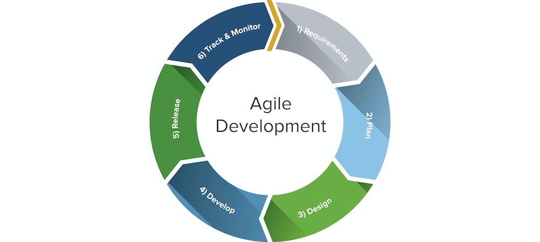


TCC Service Areas
250 IT Professionals in 20+ States
IT Managed Services
Cyber Security SOC/Infrastructure Services Cloud Hosting
Custom Software Development Learning Management
CMMI Certified Agile Development Process Performance/Leadership 3DVR (Vertex)
Notes:
Leave Here

Slide 6

TCC CLIENT BASE
WA
VT
ND
ME
OR
WI
NY
CT
MI
PA
NJ
IL
IN
OH
CA
CO
WV
MD
MO
VA
KY
NC
OK
TN
AZ
AR
SC
AL
GA
TX
FL
Current
Prospective
Notes:
TCC Current Clients:
Indiana
Maryland
Illinois
Michigan
New Jersey
Oregon
Oklahoma
Washington
North Carolina, South Carolina, Georgia (SCUBI)
TCC Prospective Clients:
Pennsylvania (Philly)
North Dakota
Arizona
Maine
Louisiana
Kentucky
Alabama
California
New York
Vermont
VSG/3I Current Clients:
Ft Benning - Columbus, GA
Suffolk, VA, JKO -
Washington, DC
Dothan, AL - Ft Rucker
TX – Jiffy Lube International, Elite Line Services (ELS , Ft Sam Houston
Fort Walton Bch, FL , Hurlburt AFB -
Roanoke, VA – Advance Auto Parts (AAP)
Nashville, TN – Bridgestone Retail Operations (BSRO) (they are also in Chicago, IL)
Racine, WI – Case IH
Akron, OH – Goodyear
Aurora, CO – Farm Credit Administration (FCA)
Kansas City, MO – Alpha Gamma Rho (AGR)
Princeton, KY – Kentucky Soybean Board
Detroit, MI – St. John Providence (part of Ascension)
Parsippany, NJ – Zoetis
Arlington, VA – BAE Systems
VSG/3I Prospective Clients:
Air National Guard Training Center, Little Rock, AR
Scott AFB – O’Fallon, IL
Ft Huachuca – Sierra Vista, AZ
Ft Bliss - El Paso TX

Slide 7

Cyber Security Landscape
Steve Palamara
Director of Business Development

Slide 8

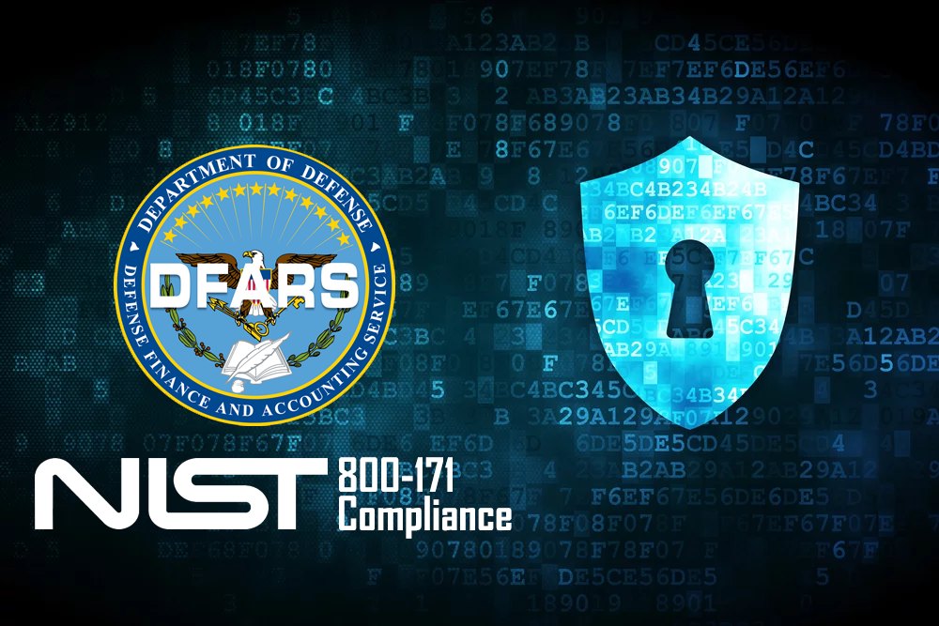
Dod – service provider requirements
300,000+ DoD Private Contractors Nationwide
NIST 800-171 Executive Order – Current Law
CMMC – Cybersecurity Maturity Model Certification Requirement Fall 2020

Slide 9


Executive order 13556
Controlled Unclassified Information (CUI)
Origin of EO 13556 – Declassify ... Share more info (CUI)
CUI – Controlled Unclassified Information
Supply Chain Impact - Flow down to Sub Contractors
“Hackers need only breach one vulnerable third party to gain access to hundreds or thousands of connected organizations. As one cybersecurity expert stated, “Supply chains have become the gift that keeps on giving for cybercriminals”
Notes:
Leave Here

Slide 10
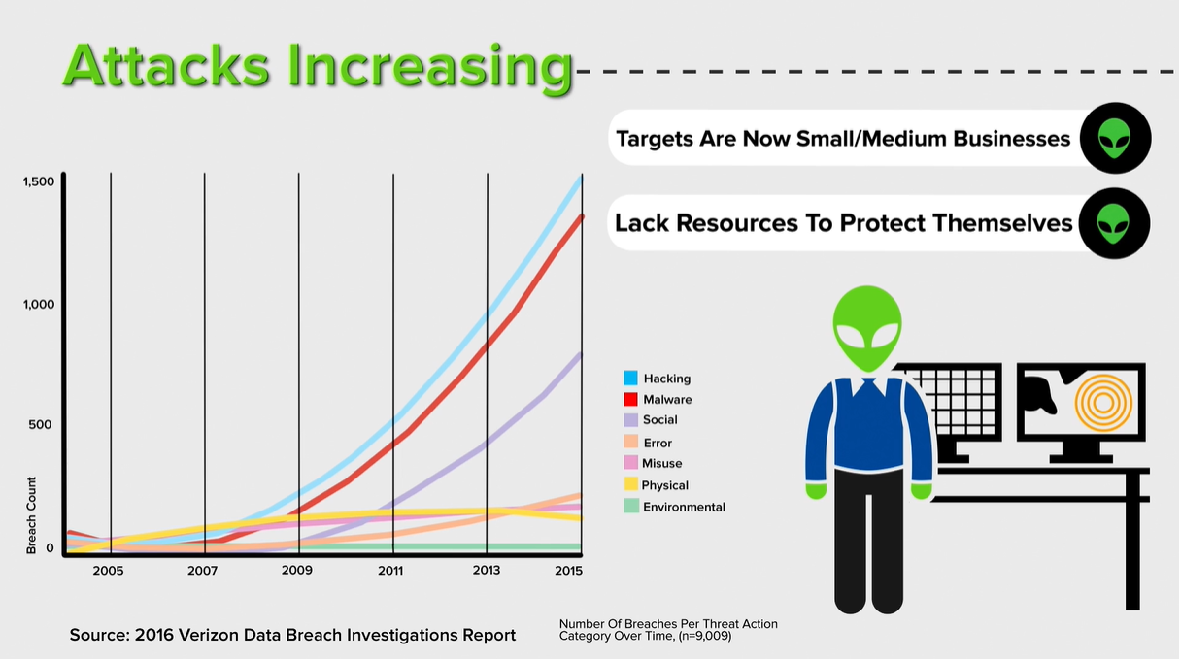
Small business threat

Slide 11
Undetected Malware lingers in smb’s
June 2019 Study- 550,000 forensic inspections
Malware - Average 800-days before discovery
  Persistent Malware
  Unwanted Applications
  Web Trackers
  Adware
Ransomware – Average 43-days before discovery
Can’t block all threats: Detection is best Prevention
Notes:
Leave Here

Slide 12

Top 5 cybersecurity threats
Malware. New malware is being created all the time. ...
Unpatched Security Vulnerabilities. While there are countless new threats being developed daily, many of them rely on old security vulnerabilities to work. ...
Phishing. (Social Engineering) Attacks. ...
Your IoT Devices. ...
Your Own Employees.

Slide 13

Case studies – cyber attacks on smb’s
Supply Chain Vulnerability – Direct DoD Attacks
Study #1: March 2019 – FEMA’s Massive Compromise!
  Personal Data “accidently” shared with Hotel placement vendor
Study #2: DoD * US Army * Dept of Veterans Affairs
  Accidentally Published
  Inside Job
  Lost/Stolen Media/Computer
Notes:
Leave Here

Slide 14
DFARS 252.204-7012
Cyber Security Model Certification “CMMC”
Tim Luzadder
Director of Security Services

Slide 15

DFARS 252.240-7012
REQUIREMENTS
NIST SP 800-171
System Security Plan
Plan of Action & Milestones
“Rapidly” Report Cybersecurity Incidents
Current Contracts and Flow-Downs
Notes:
Leave Here

Slide 16

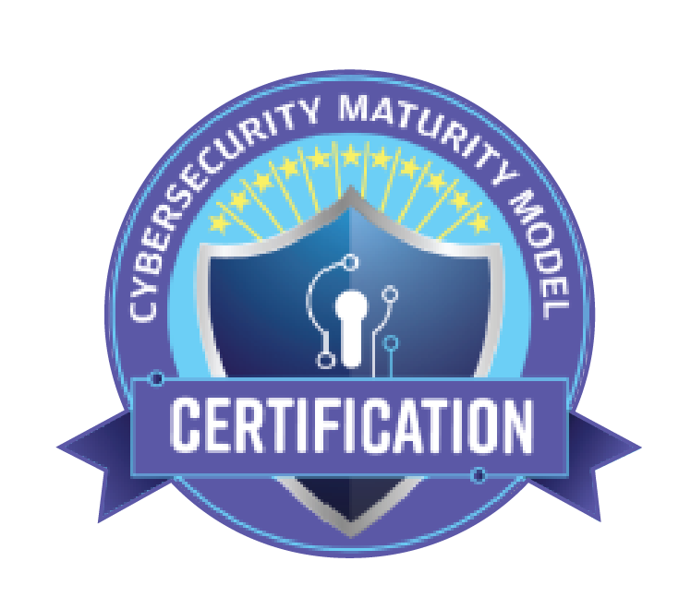
CYBERSECURITY MATURITY MODEL CERTIFICATION
Office of the Under Secretary of Defense for Acquisition and Sustainment (OUSD(A&S))
Builds on DFARS 252.204-7012
Pulls in other industry frameworks
1-5 Grading Scale of Cybersecurity Maturity
Requires independent 3rd party audits instead of self-attestation
https://www.acq.osd.mil/cmmc/
Notes:
ISO 27001, CIS Critical Controls, NIST Cybersecurity Framework
Ad-hoc > Documented > Institutionalized > Automated > Continuous Improvement

Slide 17
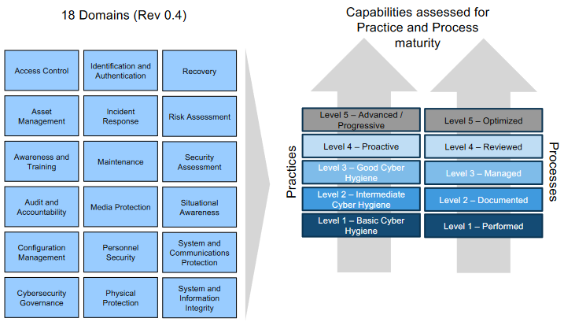
CMMC
Draft rev 0.4 – September 2019
Level 1
  Anti-Virus, IT Inventory, Auditing
Level 2
  Security Awareness Training, Access Control, Policy & Procedures
Level 3
  NIST 800-171 Implemented, Multi-factor Authentication, Continuity Plan
Level 4
  Threat Hunting, Mobile Device Management, Data Loss Prevention
Level 5
  Security Operations Center, Automation
https://www.acq.osd.mil/cmmc/
Notes:
Domains have Capabilities {Practices and Processes}
Lv 1 = 35 controls
Lv 2 = 115 controls
Lv 3 = 91 controls
Lv 4 = 95 Controls
Lv 5 = 34 Controls

Slide 18
CMMC
TIMELINE
April 2019 – CMMC Announced
November 2019 – Final Draft of CMMC
January 2020 – Release CMMC
July – September 2020 - Audits
Fall 2020 – New RFP’s will require CMMC Levels
Key Documents Still in DRAFT
NIST 800-171 rev 2
NIST 800-171 B

Slide 19
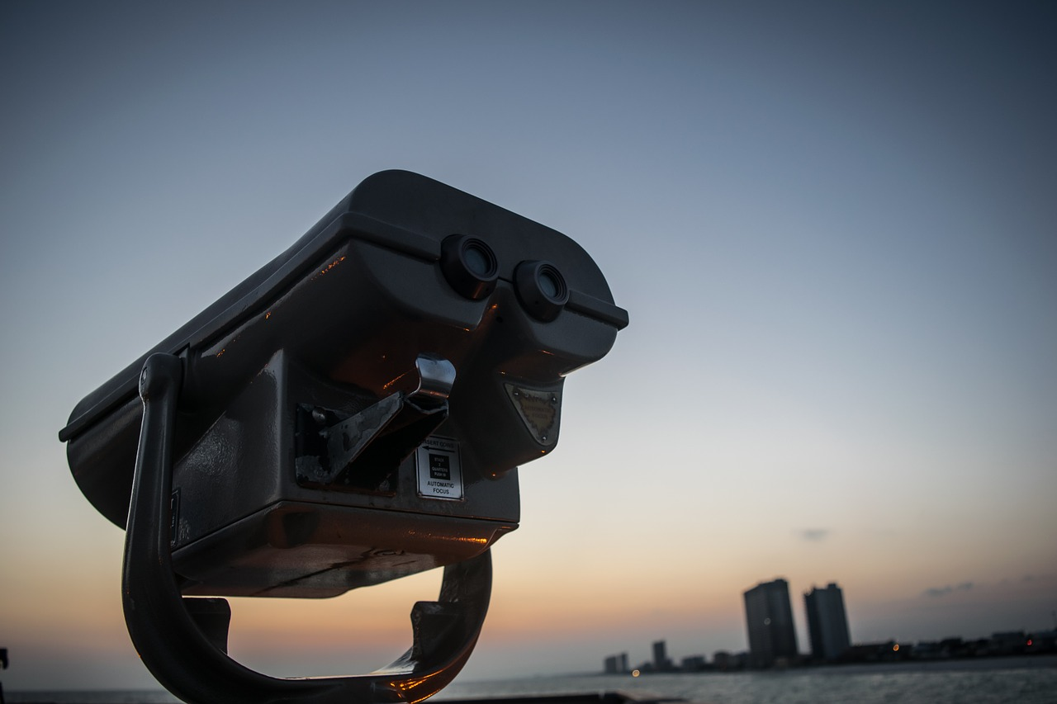
CMMC
WHAT’S NEXT?
Requirements are still in draft
Current timelines are dependent on many factors
Audits to a certain level will need evidence
Robust security programs take time to develop and implement
Start now with a GAP Assessment
Work towards closing GAPs over this next year
Evaluate your own subcontractors and compliance requirements
Notes:
Leave Here

Slide 20
NIST 800-171
Chad Hughes
Cybersecurity Architect

Slide 21

Nist 800-171
PATH TO COMPLIANCE | WHERE TO START
Step 1
GAP ASSESSMENT
Conduct a review of your current state of compliance.
Interviews with Management, HR, IT
Infrastructure review
Map current operations to security controls
Facility walk-through
Notes:
Leave Here

Slide 22
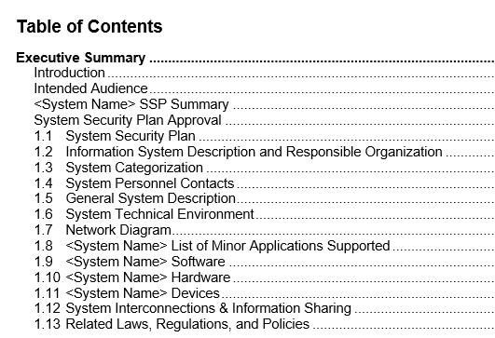
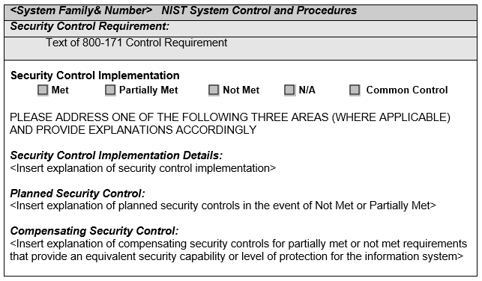
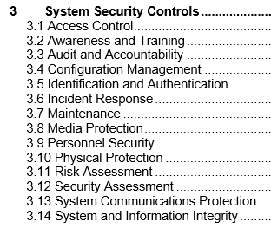
Nist 800-171
PATH TO COMPLIANCE | WHERE TO START
SYSTEM SECURITY PLAN (SSP)
Make a list of all security controls and how you plan to implement them.
Step 2
Notes:
Leave Here

Slide 23
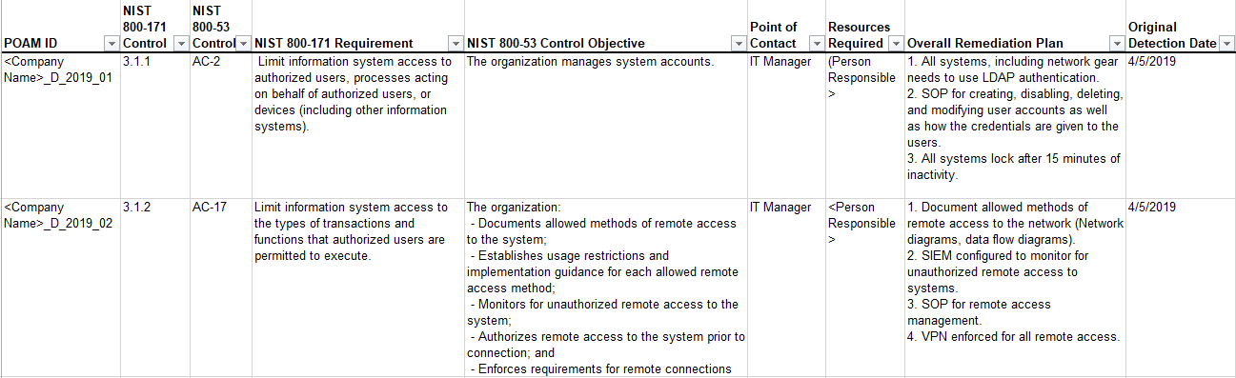
Nist 800-171
PATH TO COMPLIANCE | WHERE TO START
PLAN OF ACTION & MILESTONES (POAM)
Develop a list of initiatives that will move you closer to compliance.
Step 3
Notes:
Leave Here

Slide 24

Nist 800-171
PATH TO COMPLIANCE | WHERE TO START
Step 4
REMEDIATION KICKOFF
Follow-up analysis from GAP to monitor individual DFARS requirements. The kickoff will identify the biggest impact items to initially remediate and will set the roadmap for the upcoming iterations of Remediation.
Inventory
Documentation
Secure the building and remote access
People and Accounts
Encrypt data that is stored and data that moves
Control CUI movement
Notes:
Inventory - Computers, Networks, Users, Software, Firmware, CUI Data, etc
Documentation – Policies, Standard Operating Procedures, Diagrams, Roles, etc.
Secure the building / remote access - Locks/Badges, Cameras, Visitors, VPNs, Remote Workers, etc.
People and Accounts - Screen, Approve, Train, Assign, Passwords, Multi-Factor Authentication, Disable, etc.
Encrypt data stored and moving - Full device encryption, secure protocols for communications, etc.
Control CUI - Isolate where CUI is stored and how it moves into, through, and out of your control

Slide 25

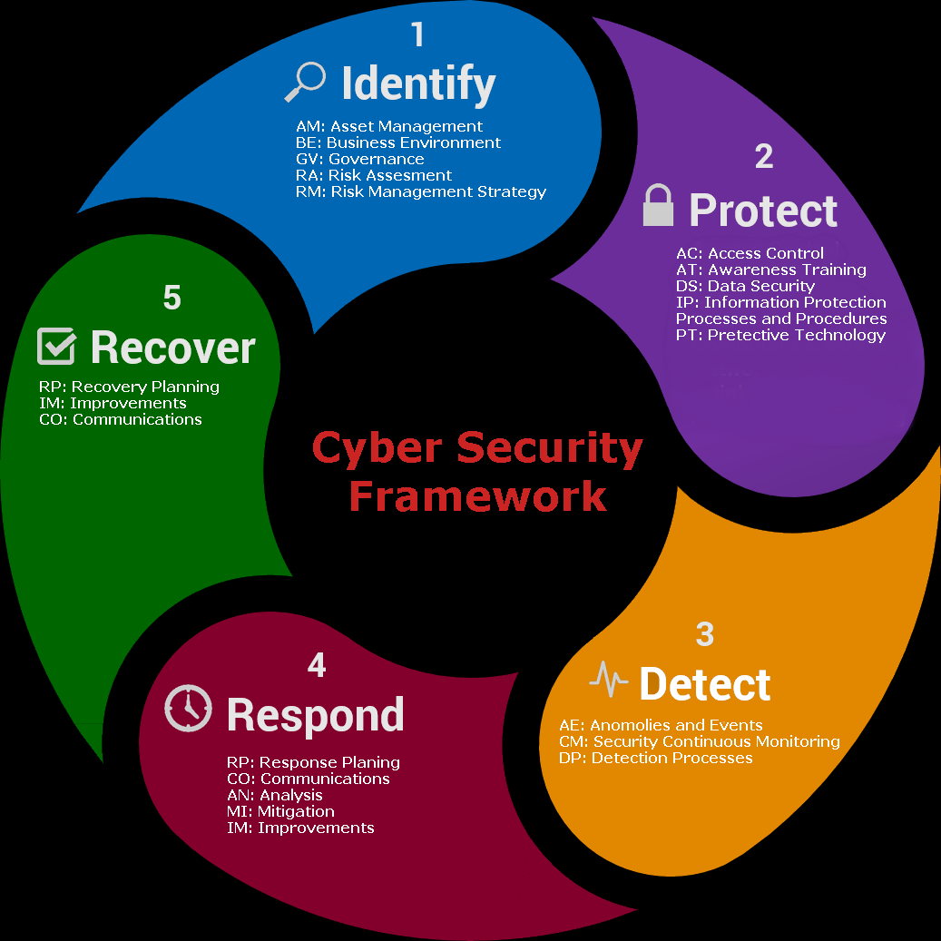

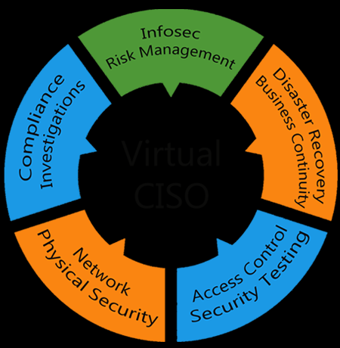
TCC – Security Operations center (SOC)
NIST 800-171 impact
110 Requirements over 14 Control Families
SIEM – Security Information Event Management
19-Controls
Threat Management
6-Controls
Vulnerability Management
13-Controls
Advisory Services
23-Controls
Notes:
Leave Here

Slide 26
QUESTIONS?

Slide 27

Steve Palamara, Director of Business Development
Stephen.Palamara@e-tcc.com
(317) 986-8118
www.e-tcc.com

