Slide 1
You are granting permission to Cyber Training Technologies, hereinafter known as the “CTT Media” to use my image (photographs and/or video) for use in Media publications including:

Slide 2
Contracting & Coffee
June 2019
nstxl.org

Slide 3
Introduction
What is an OTA?
Is an OTA right for you?
Analysis of your solution
What is a Prime or Sub?
How to respond as a Prime or Sub
Understand what they are asking
Can you meet the requirements?
Create an outline
Understand pricing strategy
Craft messaging
Proposal Terminology 101
Submission strategies
Additional info can go here
nstxl.org

Slide 4
Introduction:
NSTXL history
TReX and S²MARTS
Teresa Speck

Slide 5
What is an OTA?
10 U.S.C. § 2371b
The Statute,
How It’s Translated, and
The Impacts

Slide 6
Are OTA’s right for you?
Responsive & agile; Less Bureaucracy
Excited, motivated
More comfortable with future unknowns
Fresh mindsets & next-generation dual purpose sol
Scope - “I have the technology or have done this before”
Size - “I have the resources to complete this today”
Timing - “I have the resources to complete this on time”
Past Performance*- “Someone has bought or used my technology before”
“I can do it, but have never done it”
“I do not have the people now”
“I can do it, but just not that fast”
“I have never done this work for anyone”

Slide 7
(Be honest with yourself)
Have you developed or delivered this technology before?
Have you ever been on a team for this technology before?
How close is your technology to being scalable?
Do you have the team in place to support the request?
Do you have the financial resources to support the payment cycle?
Do you have the resources to support the administration of the request (i.e., contracting and invoicing)?
Analysis of your Solution

Slide 8
Team Lead (the Performer) vs Team Member
Team Lead
Responsible for Contractual Items and Compliance
Responsible for Fiscal Dependencies and Schedules
Team Member
Responsible for all flow down Contractual Items and Compliance
Dependent on the payment schedule agreed to with the Lead
Manages all team members and solutioning
Direct access to Government team members
Must respond quickly and completely to all data calls
Must communicate proactively with Lead Performer about all issues to include, but not limited to, schedule, pricing, & solutioning

Slide 9
How to Respond to Request for Solution
What is the ask?
Do you know what they are really asking for? Read, Research, and Ask.
Be sure to read the RFS completely and take notes as you read it. Do research on what the current solution or problem is to best understand what they have that they do not like. Be sure to very clearly understand the solution of today to solve the problem for tomorrow. Finally, ask clarifying questions to be sure you are very clear about what the problem really is to see if you can solve it.
Can you do it?
Being honest with what you can actually do and that is not easy.
Write down the problem, current solution, and what you specifically are doing today (or your solution) that is adding value to the problem better than what they are doing. If your technology solves the problem, lay out a tentative plan to solve it based on criteria of the RFS. Finally, make sure you are solving the problem within the schedule and parameters they give.
How would you do it?
Make a careful plan of how you solve the problem.
The best chance of success is with careful preparation. Make a program/project chart of the tasks you would need to do, how long it will take you, how much money it will cost, how many people it will take, the facility needed to do the work, the equipment you will need, and every other aspect to accomplish the goal of competition of a success prototype. Finally, walk away and come back to the idea and make sure you still want to do this.
How much will it cost?
Gather all the information and make sure you can and want to do this project.

Slide 10
Outline Response
Documents
Make a list-Problems
Make a list- Solutions
Response
Check off list - Solve Problem
Check off list- Respond/Format
Make a list- How to Respond
Gather the Statement of Need (SoN), Request for Solution (RFS), all Questions and Answers, and any relevant documents and research.
Make a clear outline in a format that restates the problem, states your solution, states the milestones, deliverables, IP/data rights, and pricing.

Slide 11
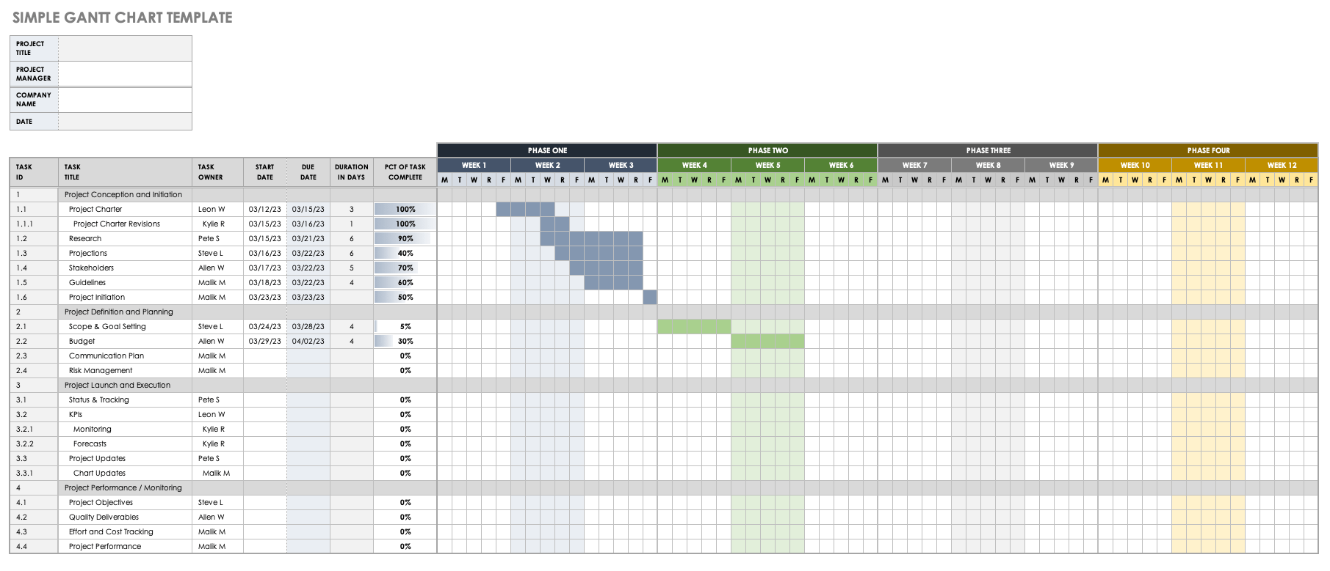
Pricing Strategy
Account for all cost and their relation to your expected growth:
People and their roles/cost per role
Equipment
Facilities
Additional software and hardware
Additional support services ( i.e., legal, accounting, HR, etc.)
*Risk (do not forget to price risk and contingency plans)*
OUR PLATFORM
NSTXL bridges the public and private sectors to accelerate the discovery, development and deployment of innovative technology solutions for operational missions and installations of the U.S. Military at home and abroad.

Slide 12
Proposal Terminology 101
Term | Definition
Amendment | A change to a solicitation before contract award.
Award | Any mechanism, signed by a contracting officer, providing government funds or other resources to an offeror that permits expenditure of such government funds or use of such government resources.
CAGE Code | The Commercial and Government Entity (CAGE) code is a five-character ID number used extensively within the Federal government and administered by Defense Logistics Information Service (DLIS).
Contract | A mutually binding legal relationship obligating the seller to furnish the supplies or services (including construction) and the buyer to pay for them.
Cost sharing | An explicit arrangement under which the contractor bears some of the burden of reasonable, allocable, and allowable contract cost.
Data Rights | (FAR Subpart 27.4) consist of the legal rights a contractor and/or the government have to use technical, Intellectual Property (IP) and software data. This data can include proposal, source selection, software, management, concepts and technical packages. ... Specifically Negotiated License Rights.
Fixed Price Contract | A type of contract that provides for a firm price or, under appropriate circumstances, for an adjustable price for the supplies or services being procured. This type of contract typically places the greater risk on the contractor.
Intellectual Property (IP) | Work or invention that is the result of creativity, such as a manuscript or a design, to which one has rights and for which one may apply for a patent, copyright, trademark, etc.
Request for Solution | A request for solutions to a particular problem identified by the Government Customer
Statement of Work (SOW) | That portion of the contract that clearly and concisely defines requirements of the specific work to be accomplished. Statements of work are individually tailored to consider the period of performance, deliverable items, if any, and the desired degree of performance flexibility.
OUR PLATFORM
NSTXL bridges the public and private sectors to accelerate the discovery, development and deployment of innovative technology solutions for operational missions and installations of the U.S. Military at home and abroad.
https://www.usa.gov/understand-contracting-terms

Slide 13
Submission Strategies
Submit completely and on time
Follow the proposal instructions and formatting
Talk less about you and more the solution of today

Slide 14
NSTXL Team
NSTXL
Teresa Speck, TReX Director
teresa@nstxl.org
Dr. Larry Solliday, SVP Acquisition and Technology
larry@nstxl.org
Bernice Glenn, SVP Strategic Membership
bernice@nstxl.org
Kasia Chaberski, Marketing and Communications
kasia@nstxl.org
Hannah Goodman, Membership
hannah@nstxl.org

